Slide 1
MIDI Bass Guitar
A Project Presented By: Owen Fujii

Slide 2
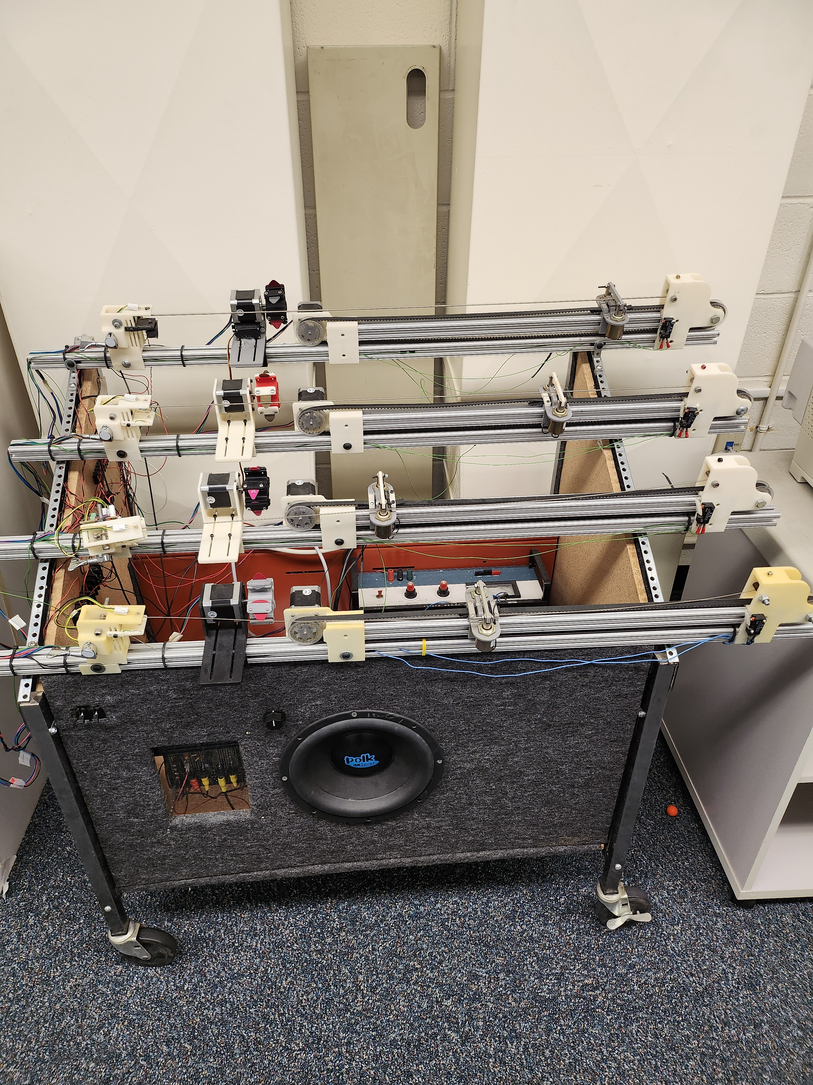
All images taken by Owen Fujii

Slide 3
Project Goals
Develop a MIDI controlled bass guitar
Bass guitar will closely match the sound of a human player
Project will have robust firmware to handle a variety of conditions

Slide 4
Semester Goals
Develop Firmware for Project
Develop Schematic/PCB for Project
Begin planning mechanical platform

Slide 5
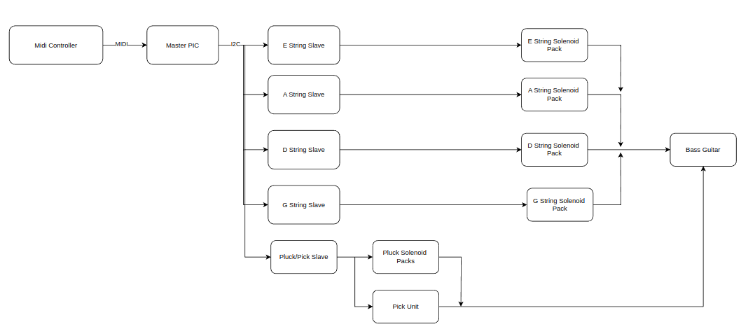
System Breakdown

Slide 6
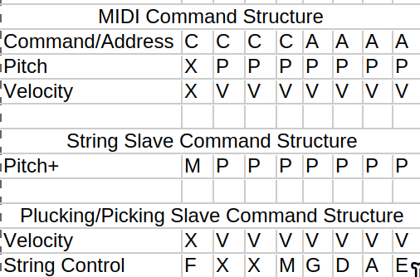
Serial Structure
C = Command
A = Address
P = Pitch
V = Velocity
M = Mute
F = Pick
G = G String
D = D String
A = A String
E = E String
X = Not used

Slide 7
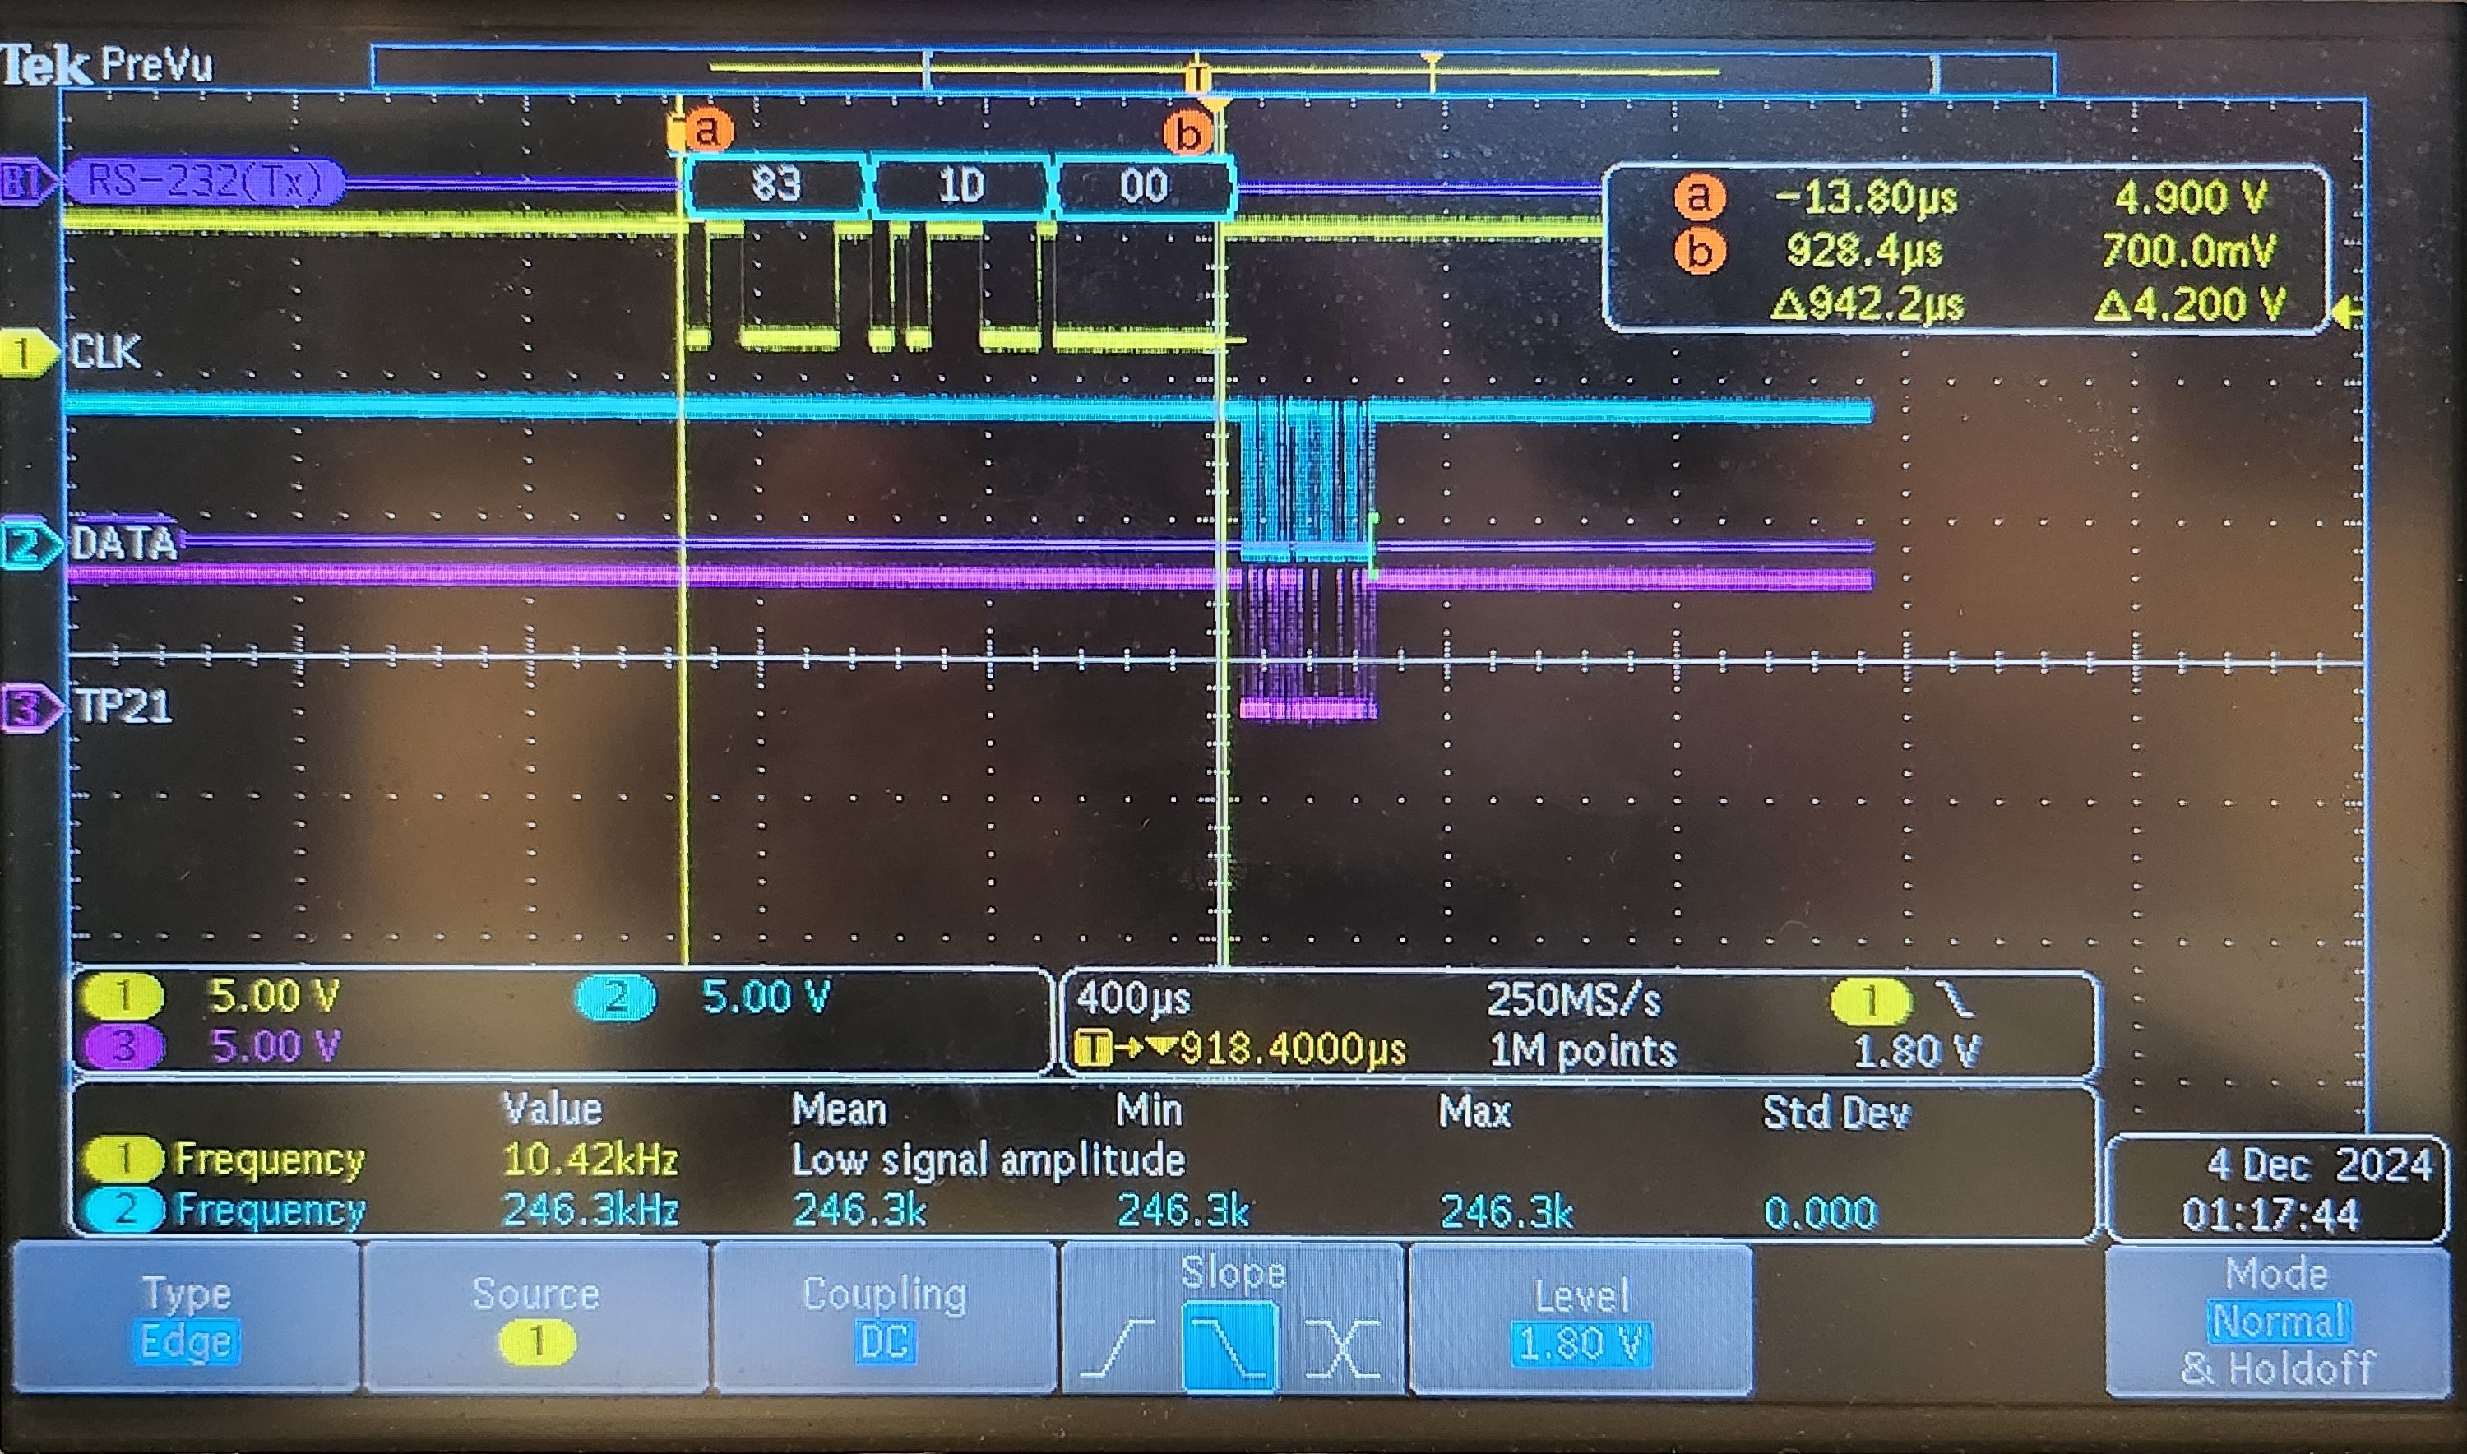
MIDI

Slide 8
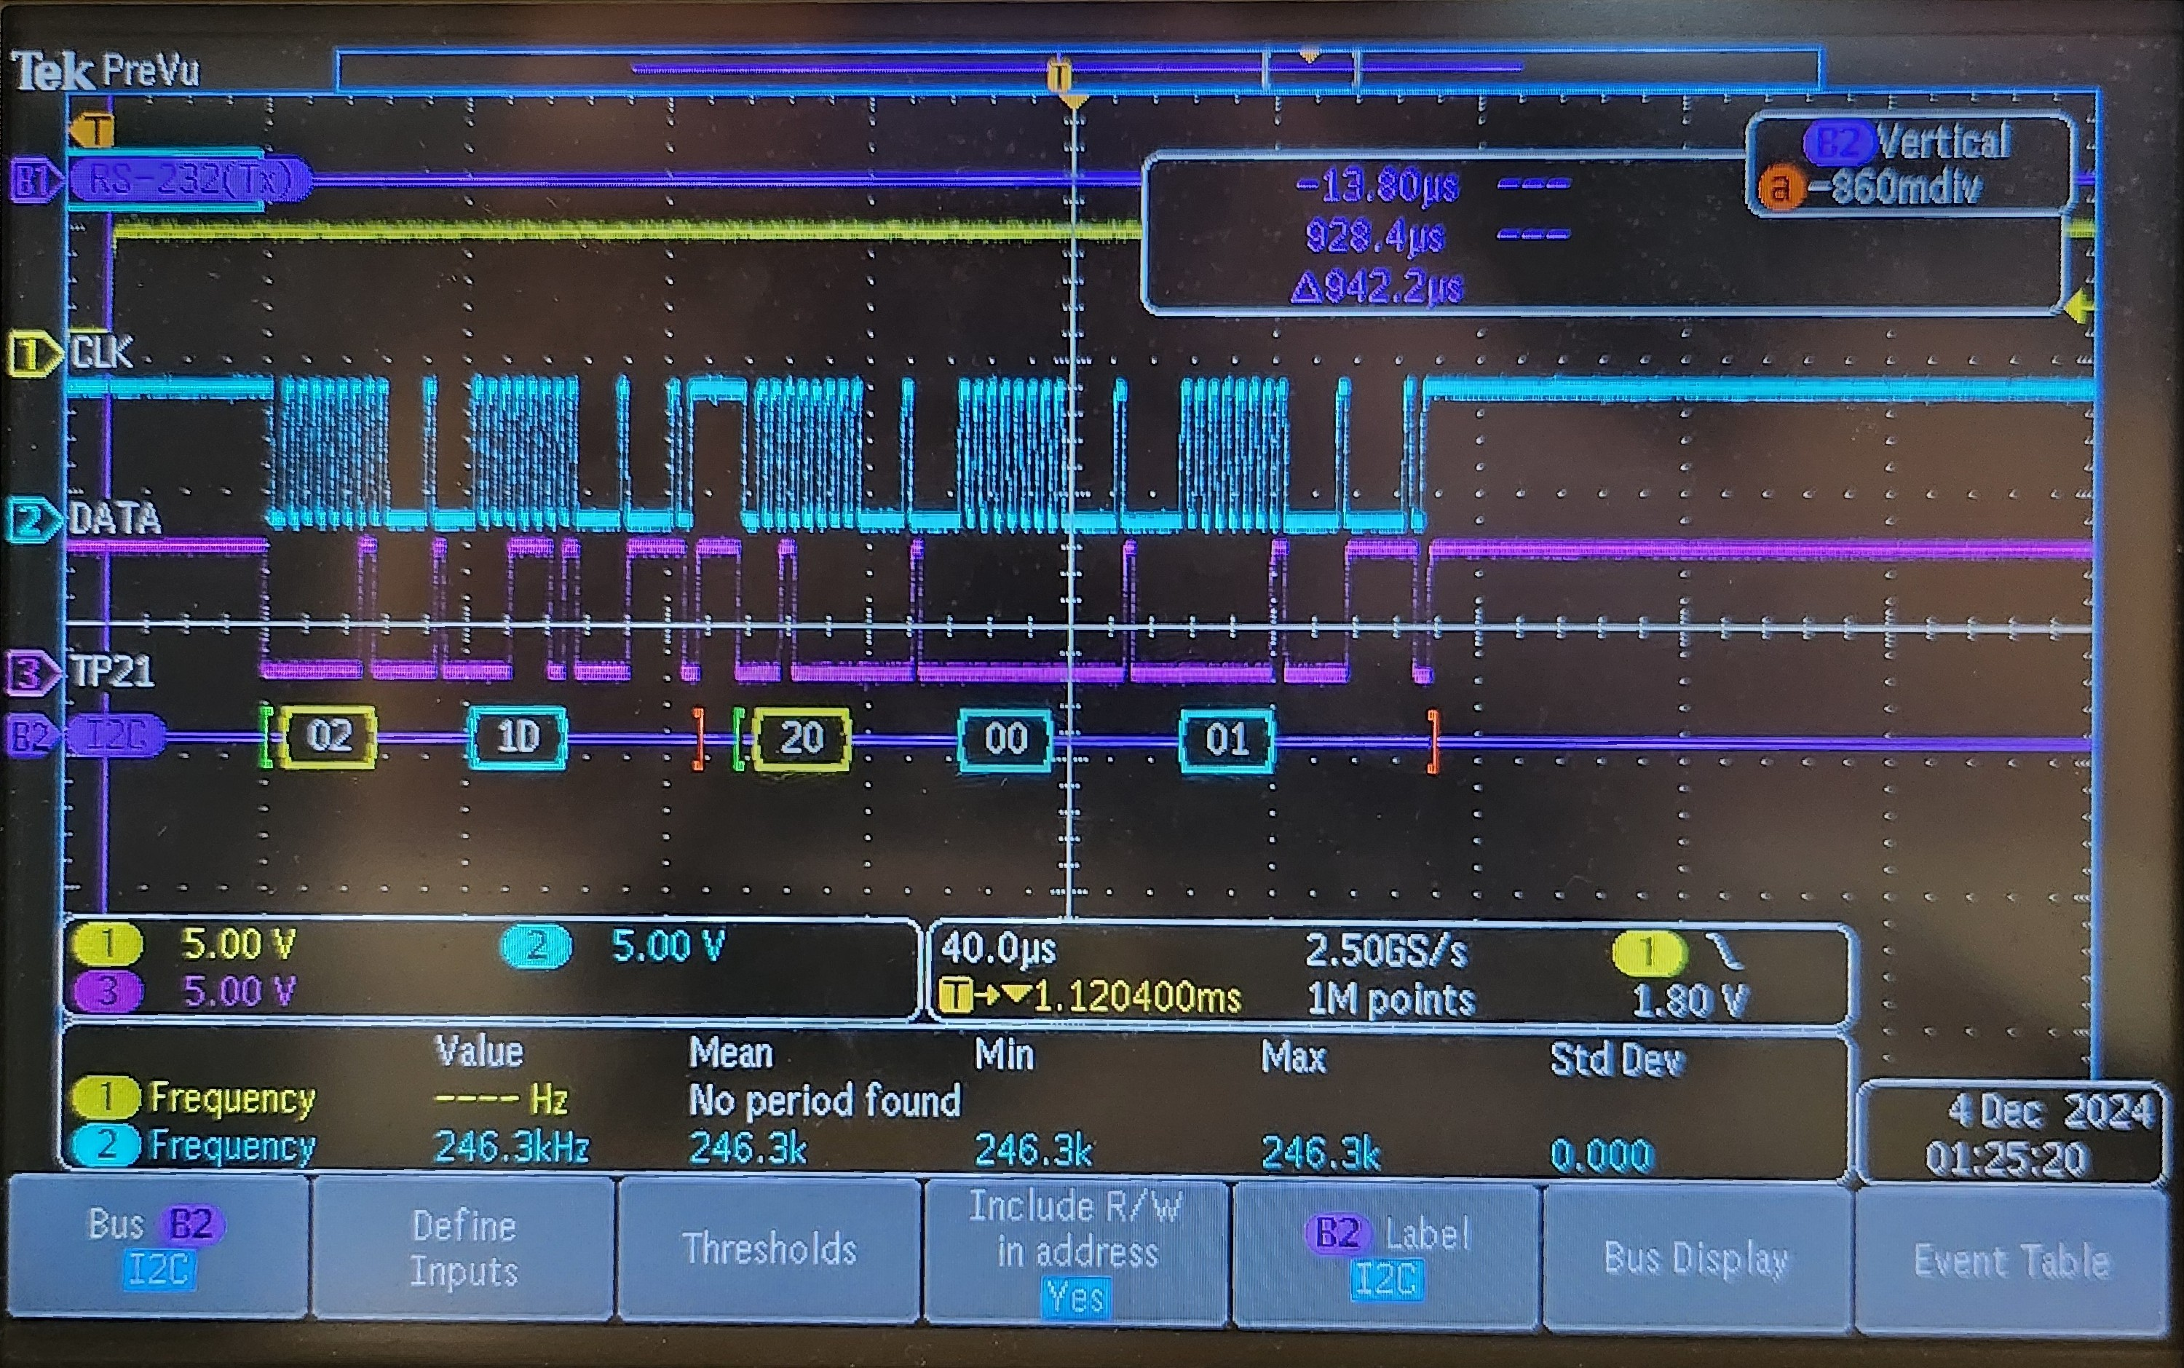
I2C
Notes:
Mention why I2C is 400khz

Slide 9
MIDI = 31.25kHz = 32uS per bit = 320uS per byte transmitted
I2C = 400kHz = 2.5uS per bit = 25uS per byte transmitted
120 Beats Per Minute (BPM)
60s/120bpm = 500ms per beat
Meaning 1/8th notes are 250ms

Slide 10
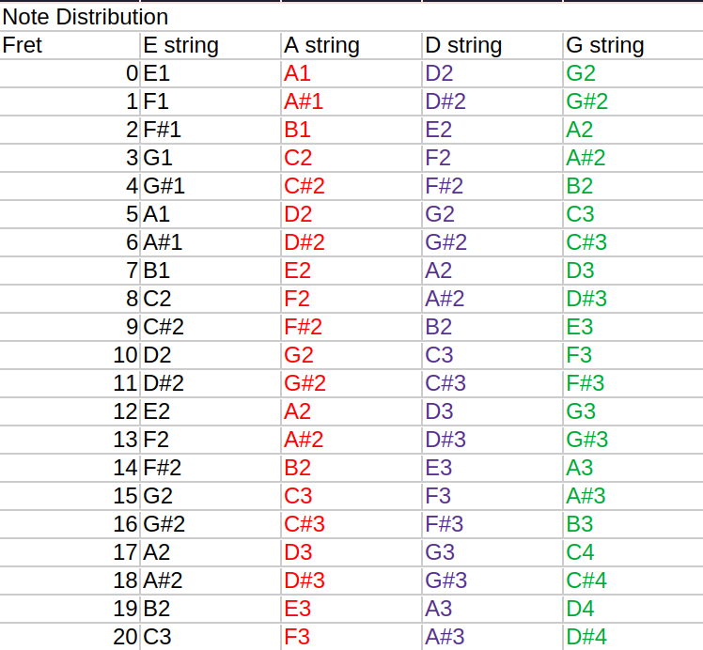

Slide 11
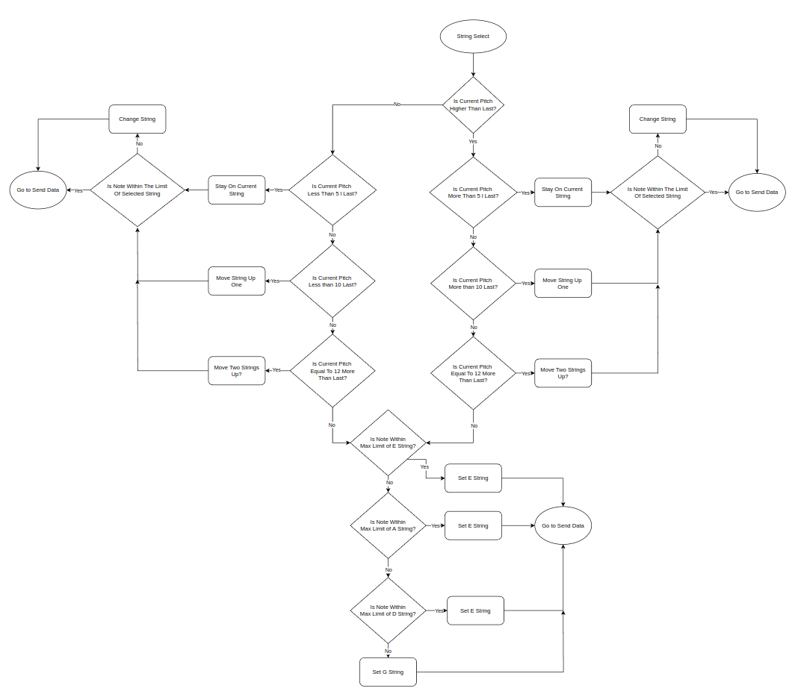
String Select

Slide 12
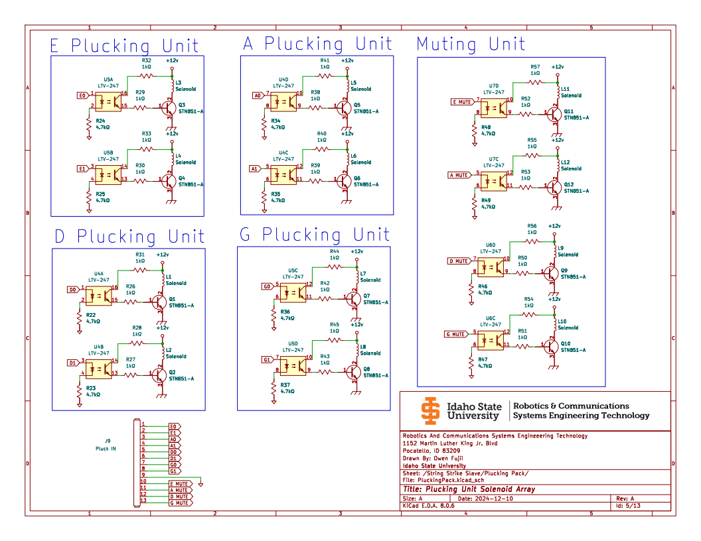
External Control

Slide 13
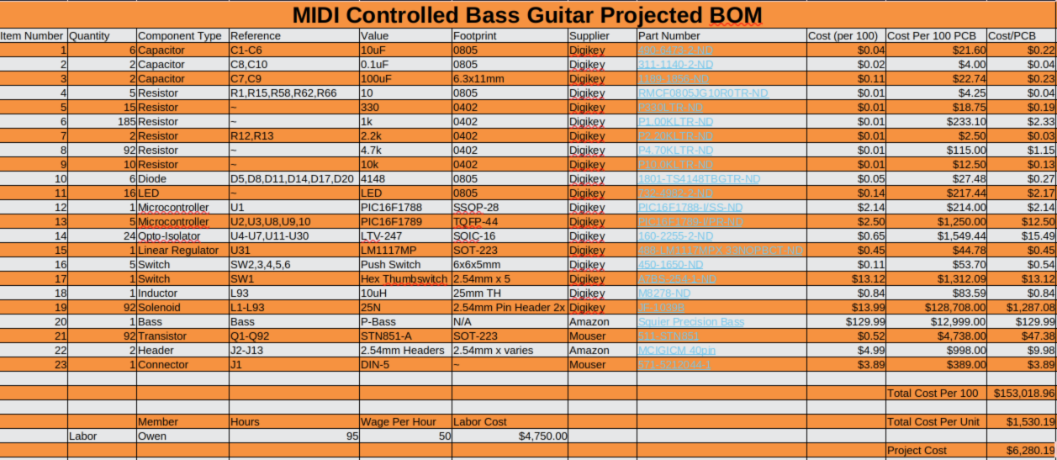

Slide 14
Recommendations
Finish developing string slave firmware
Design PCB
Design all mechanical interface hardware

Slide 15
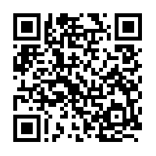
FIN
Questions?
Check out the GitHub!!

